Slide 1



STEAM GAMES ANALYSIS
FDAC GROUP 1- ZHAO QIXIAN, ALLEN LU ZHAO QUAN, KRITI RAJA

Slide 2


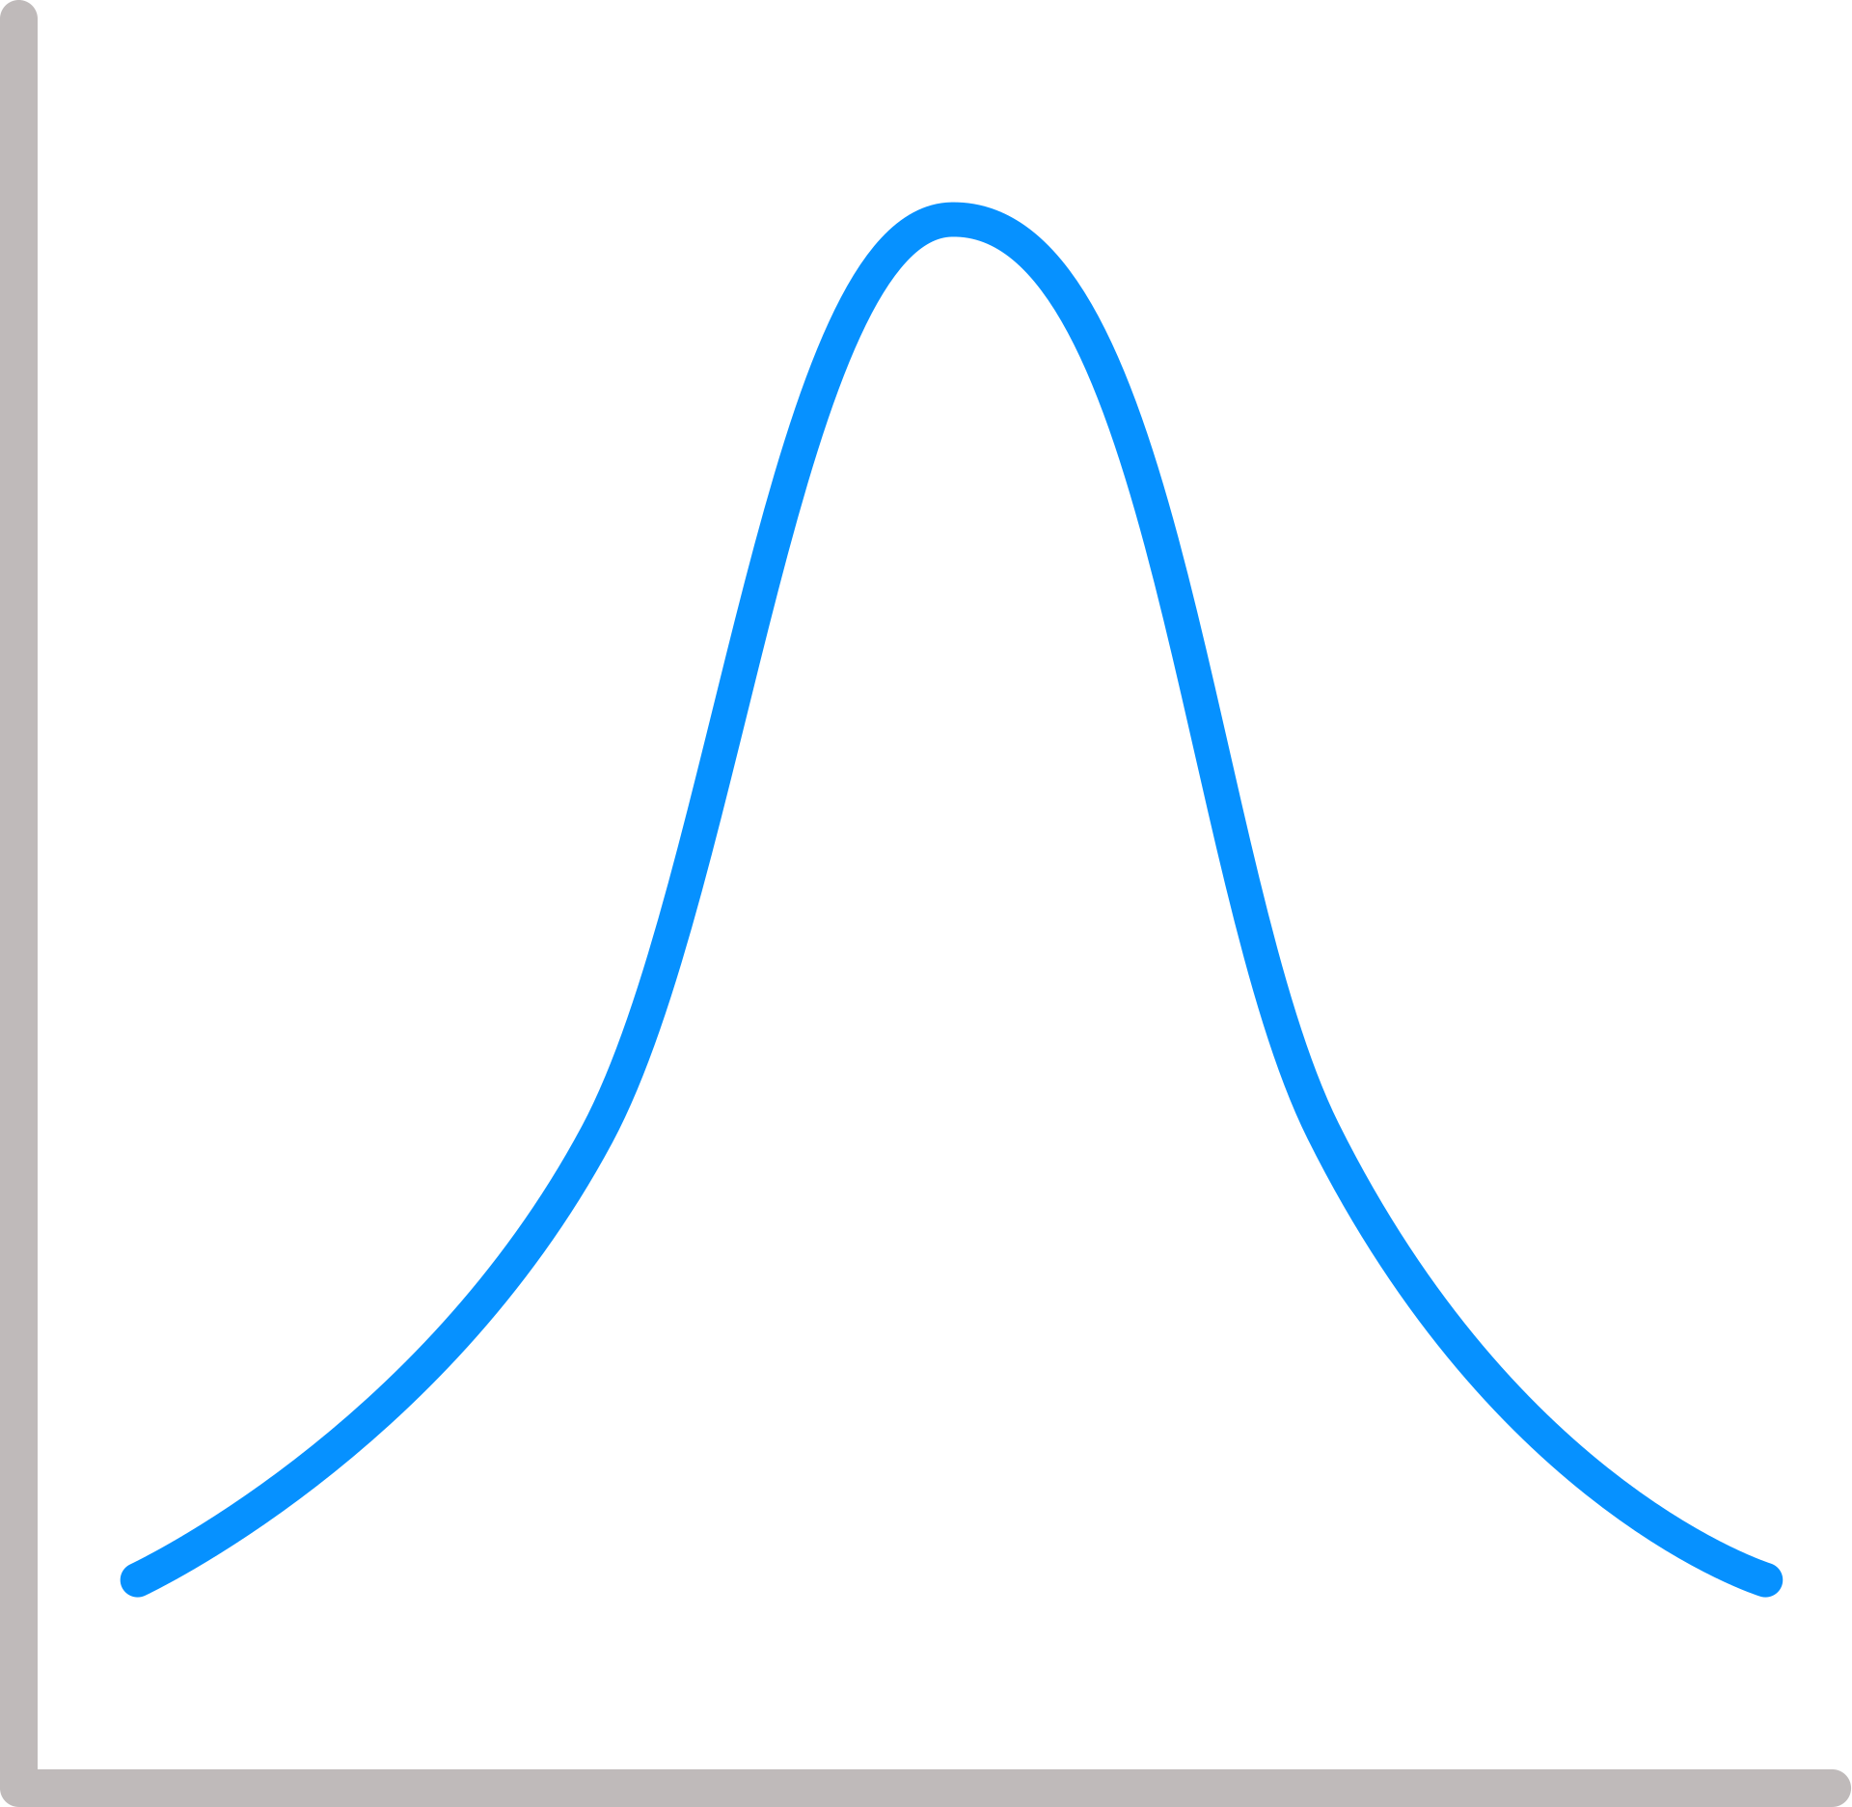




SALFORD & CO.
content
01
Problem and Dataset
02
Data Cleaning and Preparation
03
Exploratory Data Analysis
04
Machine Learning Methods
05
Conclusion

Slide 3
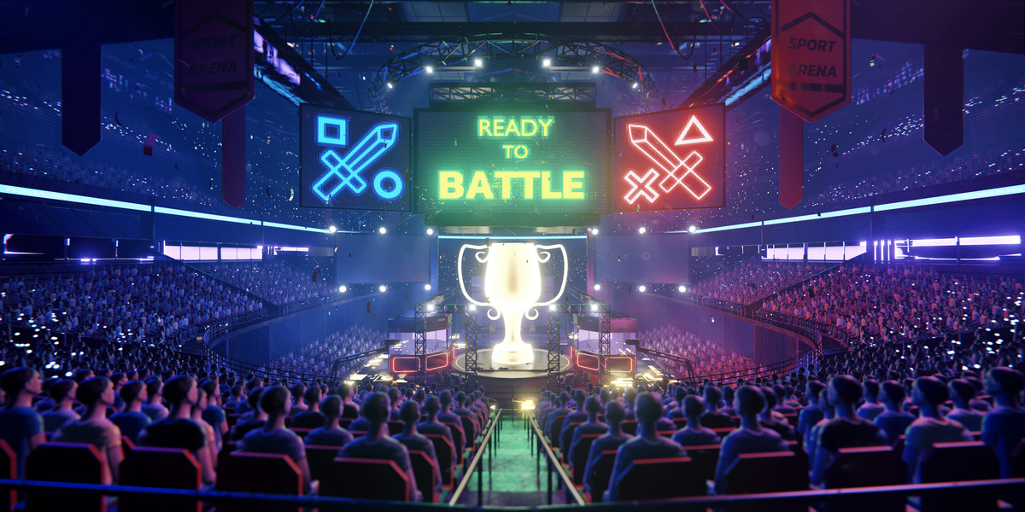

our primary questions:
“How do the features of the game affect the rating of it?”
“What should the developer consider to create a game that does well?”

Slide 4

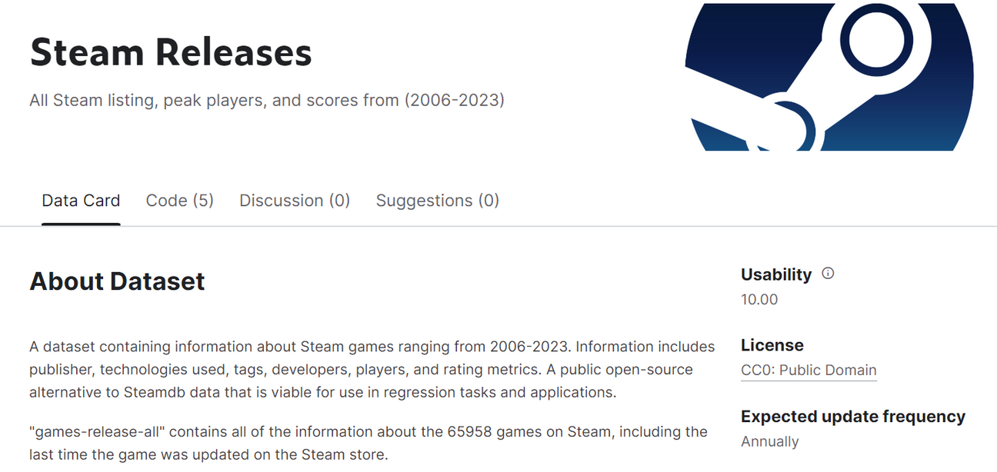
Our Chosen Dataset: ‘Steam Releases’ from Kaggle

Slide 5
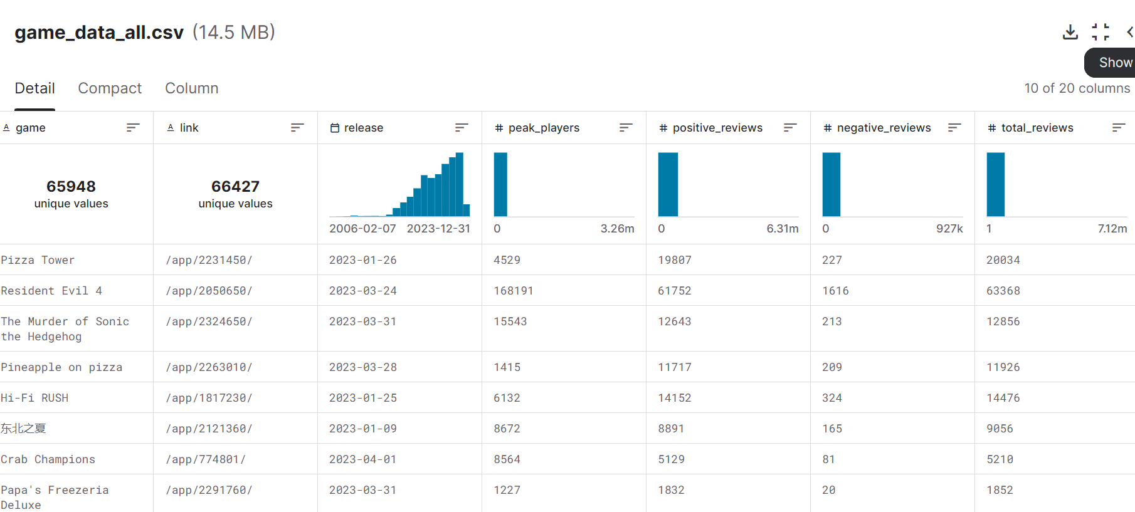
Categories in Our Dataset:

Slide 6
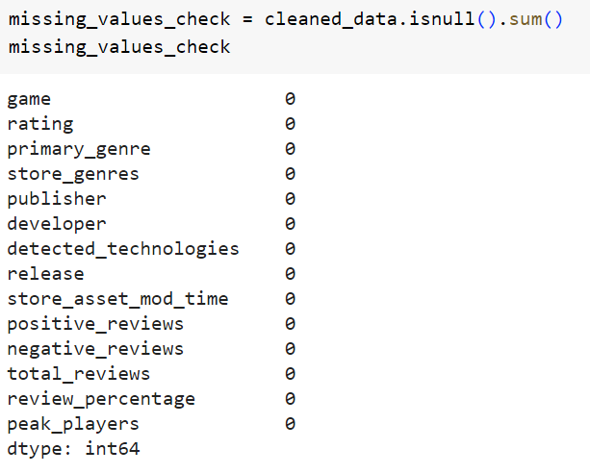
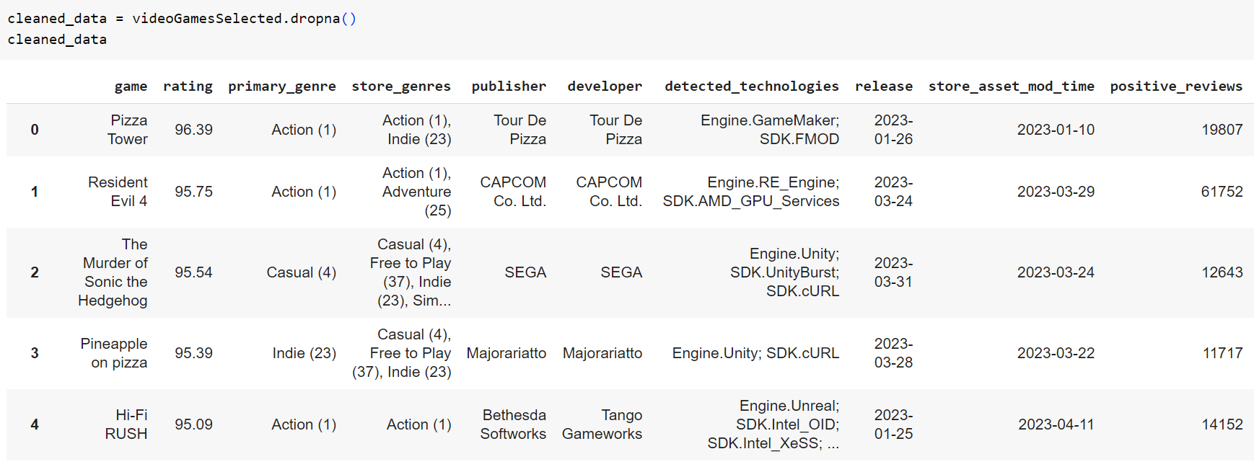
step 1: cleaning the dataset
Ensuring All NULL Values are Removed:
Removing NULL Value﻿s:

Slide 7
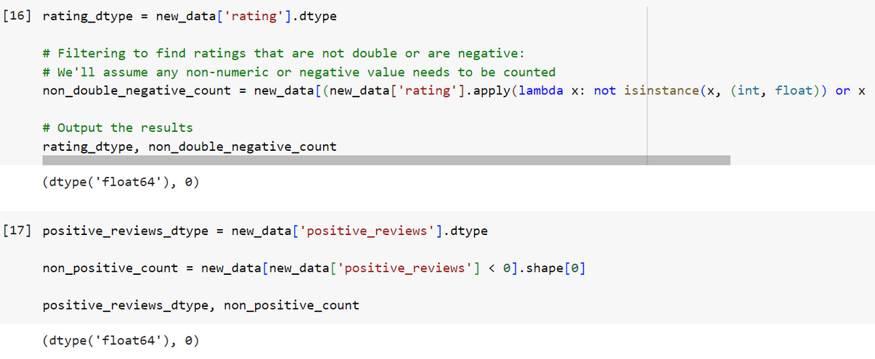
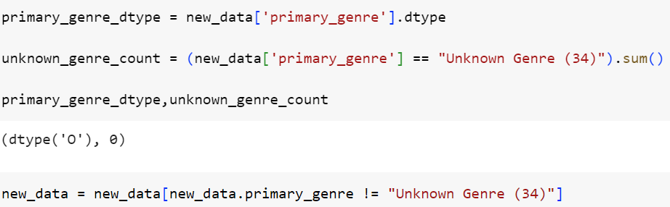
Removing wrong values
e.g. non positive values in positive_reviews:
Removing unknown genre values in primary_genre:

Slide 8
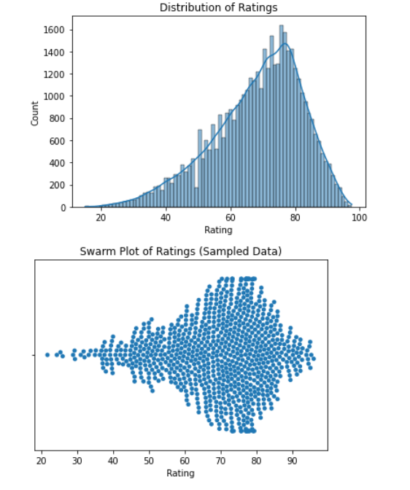
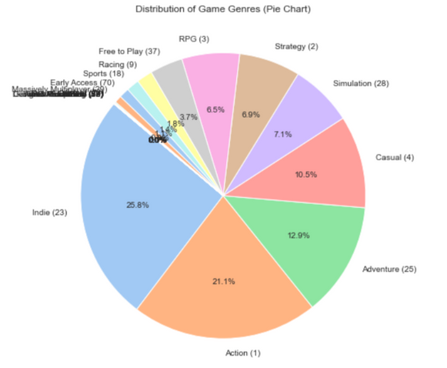
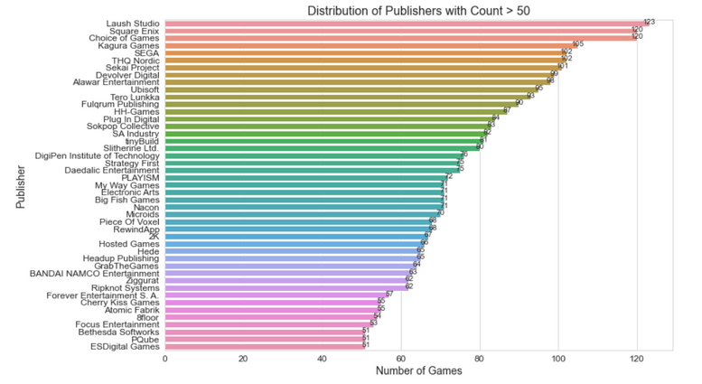
step 2: data exploration
Visualization of game genres using﻿ pie chart:
Visualization of publishers with more than 50 games released using barplot:
Visualization of rating using swarmplo﻿t and histogram

Slide 9
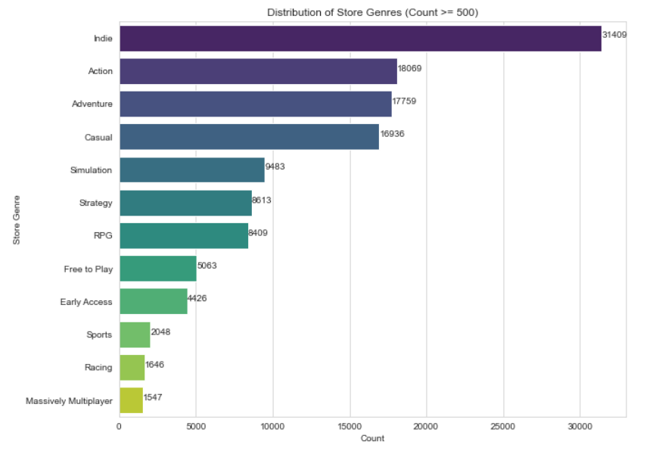
Most popular store_genre: indie game﻿s

Slide 10
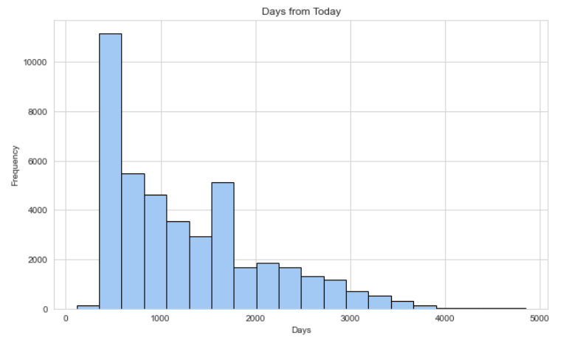
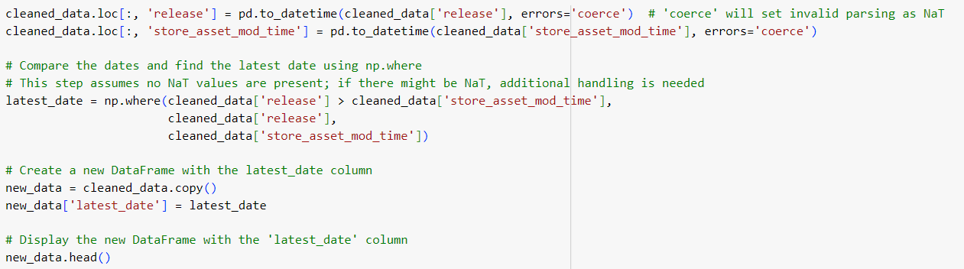
Histogram showing number of days from today:
Comparing datetime objects ‘release‘ and ‘store_asset_mo﻿d_time‘ to obtain latest date of modification by developer:

Slide 11
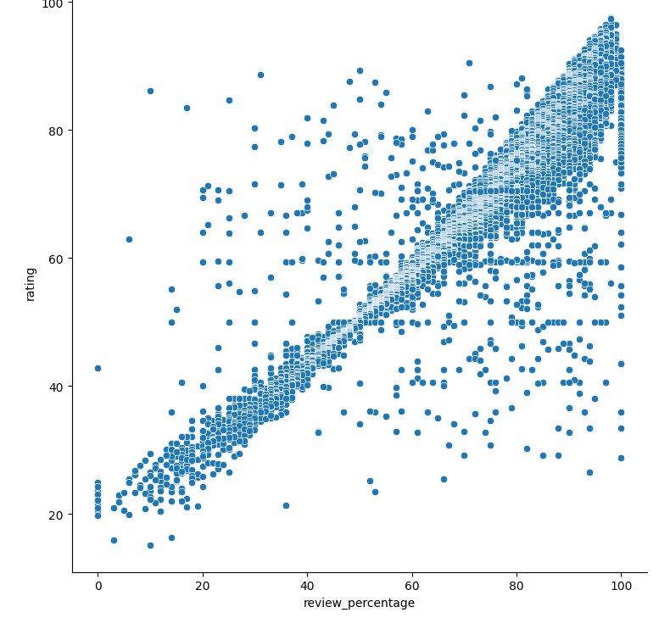
step 3: correlation between variables and rating
Review_percentage against rating
CORRELATION VALUE = 0.93

Slide 12
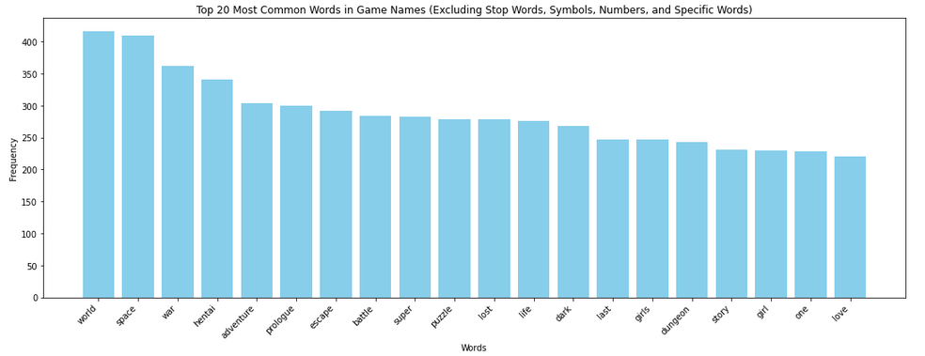
step 4: machine learning mdoels
Metrics of multi﻿-variate linear regression of all numeric variables:
Goodness of Fit of Model Train Dataset Explained Variance (R^2) : 0.0007905 Mean Squared Error (MSE) : 180.50
Goodness of Fit of Model Test Dataset Explained Variance (R^2) : 0.00107
Mean Squared Error (MS﻿E) : 178.86
Results of text mining showing mo﻿st common words in game names

Slide 13
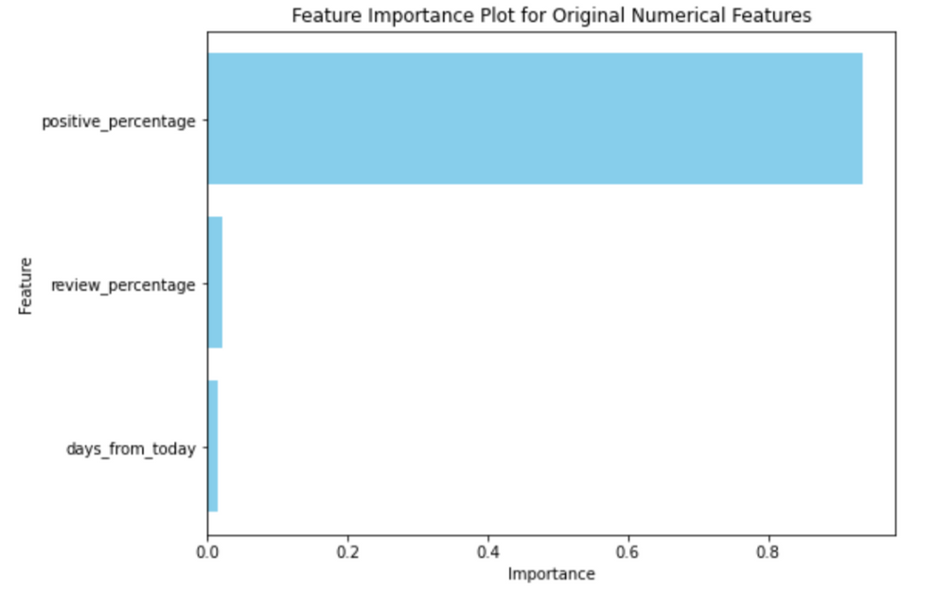
Results of random forest model
Random forest model metrics:
MEAN SQUARED ERROR (MS﻿E): 10.981
MEAN ABSOLUTE ERROR (MAE): 2.452
ROOT MSE: 3.314
R^2: 0.940

Slide 14
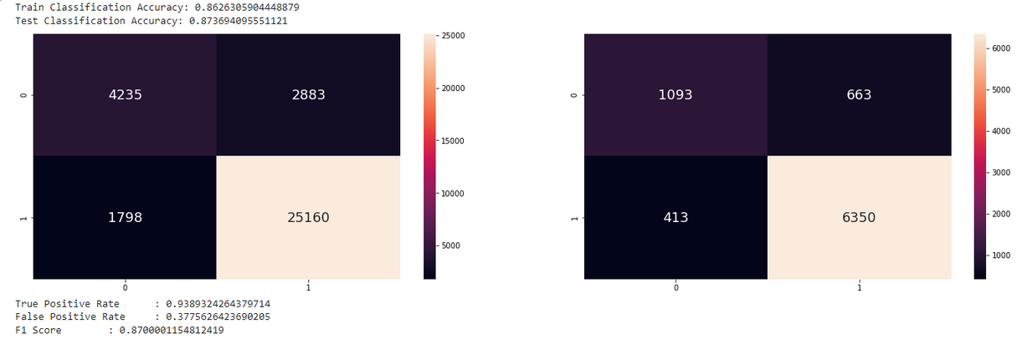
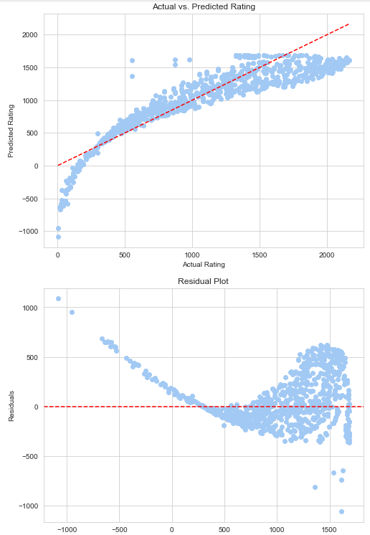
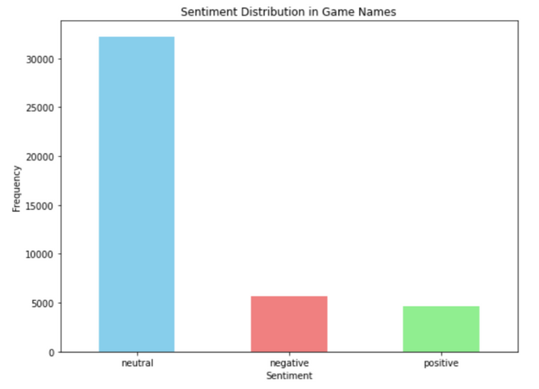
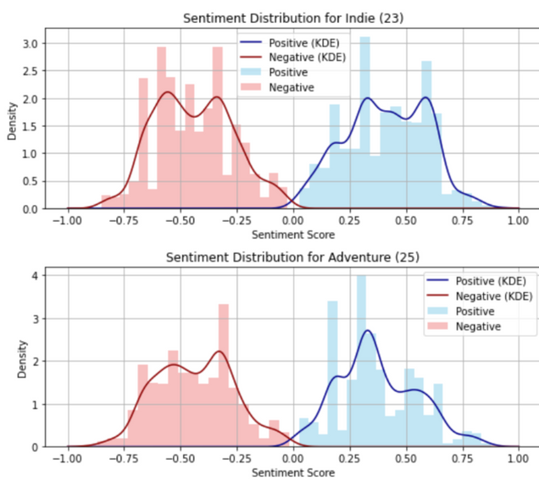
Classification Trees
Support Vector Regression
Sentiment Analysis

Slide 15
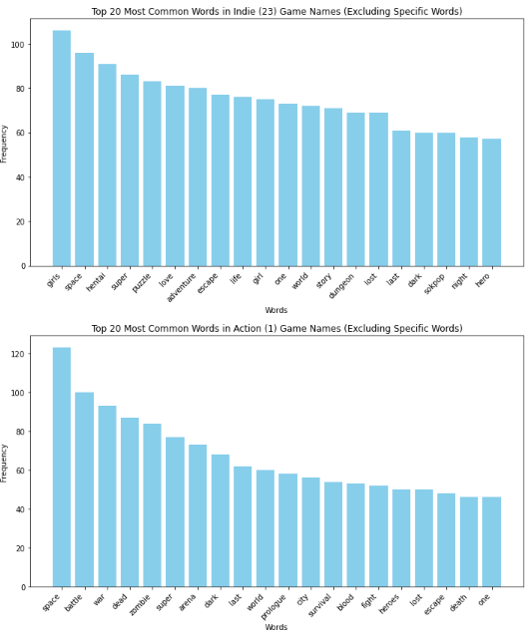
Best to estimate rating: review_percentage
Text mining model

Slide 16
aNSWERING OUR QUESTIONS:
Most Important factors are:
Themes of Game [text mining]
User-Developer Interactions [review_percentage]

Slide 17

Thank You

